Slide 1
Andrea Chamorro – Internship Summary Rapid automation – analysis for developers (RAAD)

Slide 2






What is Telemetry?
An ecosystem of tools and FW enabling
speedy root-causing when a drive fails.
Tools that Extract, Pre-Process Data and Metadata
Tools that Tokenize, Cross-Language, Data Structures for Making Sense of that Data
Tools that Provide Tangible Business Insight (and Internal Insight) via Machine Learning Data Analysis.

Slide 3
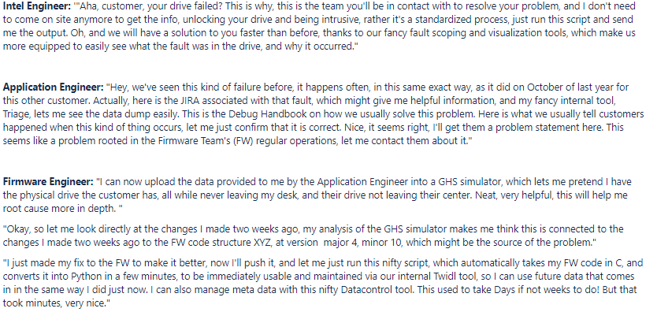
What is Telemetry?

Slide 4
Datacontrol Gen Tool
Metadata Management Tool
Synchronization Metadata Control Files
Automated and Defined Reservation Process
Enabling Metadata Processing, Scalability and Compatibility for Telemetry

Slide 5



DataControl Gen Tool
SCRIPTS & UNIT TESTS
INPUT VERIFICATION & GUIDED COMMAND LINE UI
TRAINING
WEBINAR & 1:1
THOROUGH DOCUMENTATION
CROSS-REPO FILE SYNCHRONIZATION

Slide 6
PacmanICpy API
Connecting Telemetry Tools Into One Visualization Tool
A single API that Connects Telemetry Flow From Start to Finish:
Build to Tangible Parsed Objects
Lightweight Telemetry Script Overlays Binary Over Parser to
Coherently Display Telemetry Structure Values
Linking Block Enabling Telemetry Analysis efforts

Slide 7
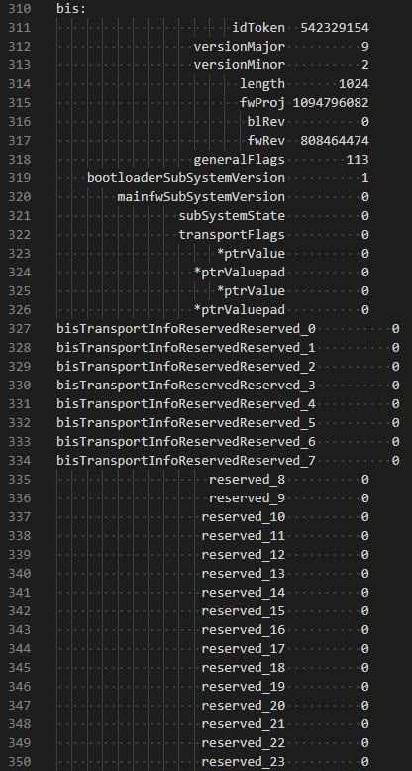
PacmanICpy API
Connecting Telemetry Tools Into One Visualization Tool

Slide 8
TwidlDict Gen API
Telemetry to TWIDL Compatibility
Connect Telemetry and TWIDL through compatible Addressable Dictionary Format
Easy Interface with just the right data to meet the spec
Enabling Telemetry Internal Integration

Slide 9
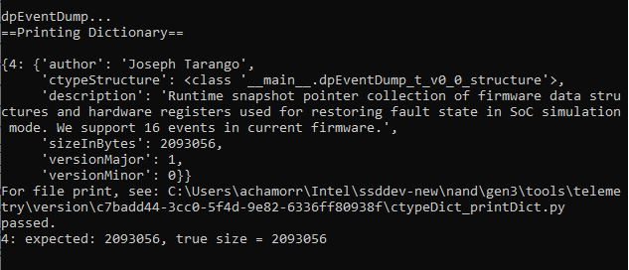
TwidlDict Gen API
Telemetry to TWIDL Compatibility

Slide 10
SWCP’19 Telemetry Presentation
Led Discussion in Folsom on Telemetry Efforts
Presented Telemetry at Internal Conference in Folsom, CA
Created Abstract and PPT presentation, presented to internal audience online and in-person along with Rutvij and Purav
Professional development and connected with Tools Team in Folsom

Slide 11
Parse | RAAD One API
Enabling Parse Aspect of Telemetry Rapid Analysis API for Customers
Integrating Existing Parse Functionalities into API
Coding to the API Standard and Documentation
Cross-team integration

Slide 12
NVMe-CLI API | RAAD One API
Interface with NVMe-Cli for
Telemetry Pulls
Enables dependency from TWIDL in an easy-to-use Python format
Allows reading payloads at the UID level, returns dynamically
Cached implementation for fast reads

Slide 13
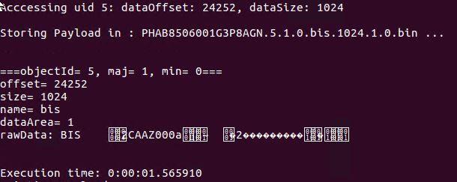
NVMe-CLI API | RAAD One API
Interface with NVMe-CLI for
Telemetry Pulls

Slide 14
Telemetry Whitepaper
Internal Overview of Telemetry Efficiencies and Progress
Overview of progress in the last year
Time Complexity breakdown experiment
Communicating efforts and value to a general layman audience

Slide 15
Patents
Three Submitted*
AC3377- Method and Apparatus for Automated Telemetry Fault Scope Reduction (ATF)
AC3375- Method and Apparatus for Automated Telemetry Data Extraction Bank for Storage Device Data Mining (ATM)
AC2838- Method and Apparatus for a Continuous Dynamic Data Control Transpiration for Telemetry (CDT)
* Status Do-Not-File, will hopefully turn into Conference Proceedings, or future IDFs

Slide 16
TELEMETRY FINDINGS

Slide 17
Results and Gains *
Overview of Internal Efficiencies
and Progress
Jira NCT Data Pre-telemetry vs Post Telemetry Illustrated
~13 day improvement in the completion of an NCT ticket
Higher number Correctly Targeted NCTs
Duplicate Issues now Turned Around Same-Day
* Thank you Telemetry Metrics Team, Results Product of Case Study of DellEMC

Slide 18
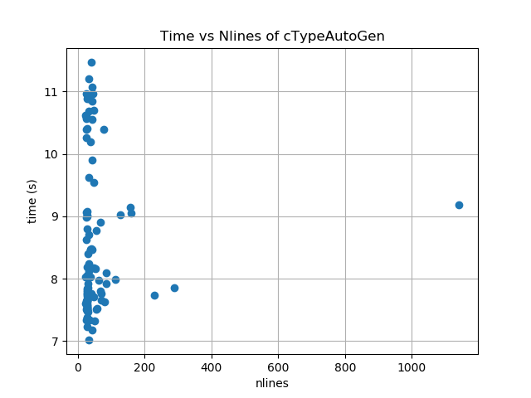
Results and Gains *
Analysis of Time-to-Data Structures
O(1) to Translate Data Structures In SSD Repo*
Developer Time Eliminated – for Automatic
8.2 Second** Time-to-Translation.
Standardized, Efficient Structures- Structures created to be efficient and meta-data enabled, automatically.
* Based on Case Study of 102 structures
** Mean 8.2 Seconds Translation for Between 22 and 1142 Lines of Code

Slide 19
Results and Gains *
Improvements and Insights
Bottleneck Not Related to Number of
Lines Produced, but to Recursiveness
Most Structures are Small*
Outlier is AssertDump -
1000 lines of Code at 9.1 Seconds
* Median 29 Lines of Code

Slide 20
Soft Skills
What is an Internship About?
Working in a cross-team environment. Learning to bring opinions together towards a shared goal. Teamwork makes the dream work.
Overcoming ambiguity. Problems don’t have straightforward answers, particularly in R&D. Having a repertoire of tools. Being comfortable pushing what we know.
Exploring Technologies and Ideas. Developing a development flow. Tools. Debug. Self-management. Communication. Inspiration.
Intel is full of Interesting Technologies and Forward-thinkers.

Slide 21
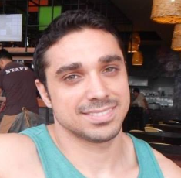
RECOGNITIONS
Special Recognition
Joe Tarango,
Intern Mentor
Jim Baca
Tyler Woods
Sanjeev Trika
Justin Gottschlich
Daniel Wright
Roberto Reyes
Vincent Quach
Alberto Sanchez
Quinn Quintana Phuong Tran
Randy Eike
Philip Low
Matt Beyer
Rutvij Karkhanis
Purav Vadodaria
Subha Sekaran

Slide 22
THANK YOU
Notes:
THANK YOU

Slide 23

Notes:
END OF PRESENTATION

Slide 24
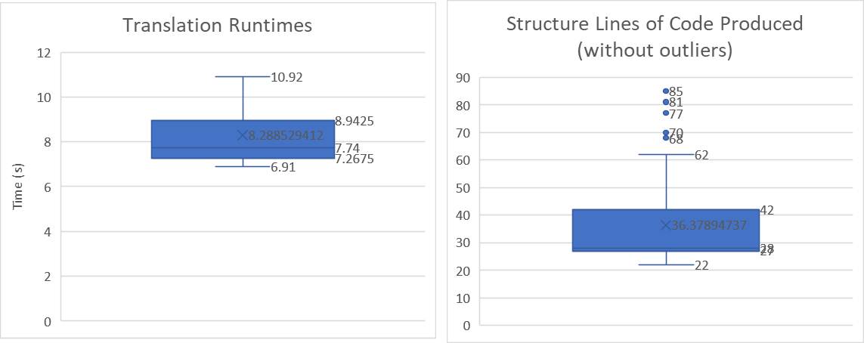
Appendix
Figure 1. Data Profile of Runtimes and Lines of Code

